Slide 1

CDE Advisor Presentation
Date : 17/1/2024
Prepared by Muhammad Zariff Wafiy
Presentation to Data Delivery

Slide 2
Content Overview
1.
2.
3.
Background, objectives, business pain points, methodology & timeline
Model mechanism, tools used
Optimization, future improvements and challenges
03
10
17

Slide 3
Background
3

Slide 4
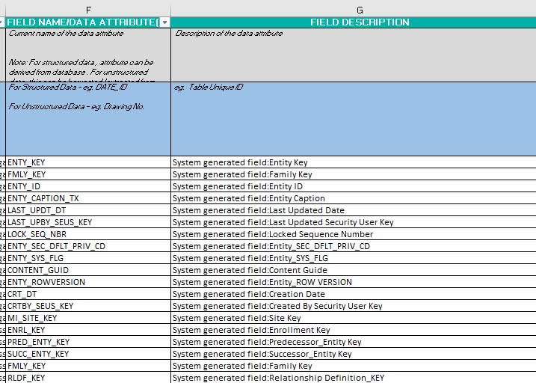
Background
Discussion with business and manual input
Eyeball data elements inside data standard
Compare with technical metadata
Sample of Data Dictionary

Slide 5
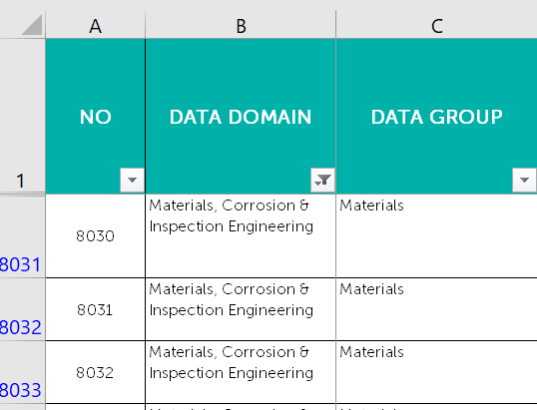
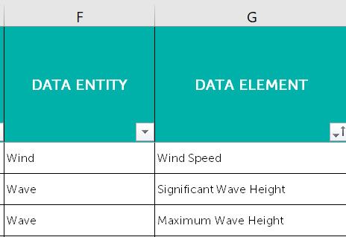
Background
Data standard (Data Entity & Data Element)
Data Standard (Data Domain & Data Group)
*data domain, data category is identified by discussion with business

Slide 6
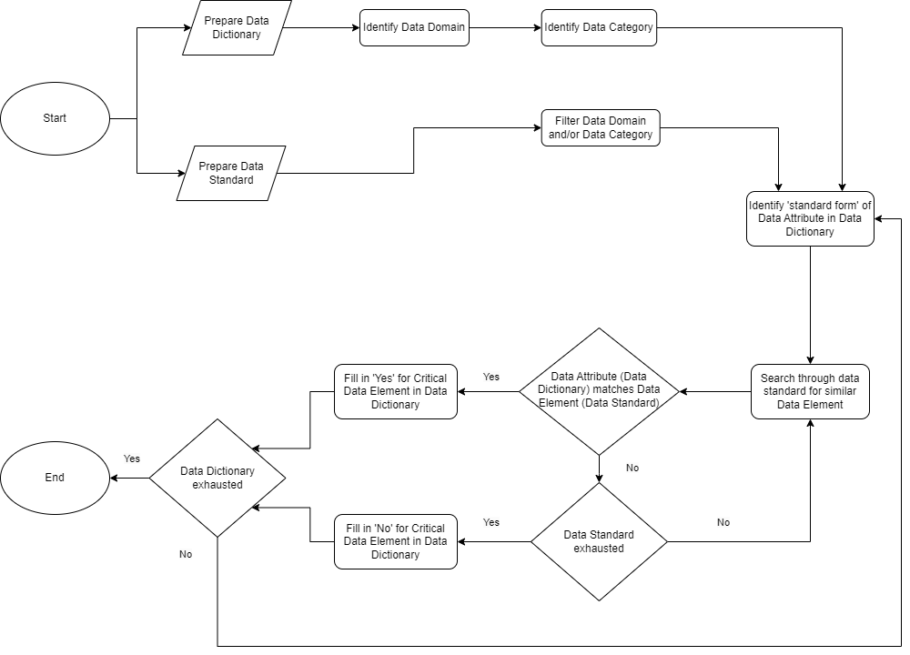
CDE
Classification
Process
Pain Point 1
Pain Point 2

Slide 7


Business Pain Points
Pain Point 1
Attributes in short form & hard to match in data standard
Inaccuracy of identifying matching data element
Guesses / estimation
Prone to Human error
Pain Point 2
High volume of attributes for manual matching
Takes a lot of time
Inefficiency of classifying critical data elements

Slide 8
Objectives
To build a working machine learning model that can perform semantic similarity matching
To develop a suitable prototype UI that users / personas can use
1
32

Slide 9
Initial Methodology
Data Dictionary
Model
Data Standard
Pass necessary attributes regarding a data element as input
Search data elements that are similar to input
Technical metadata/ List of attributes regarding data elements
Recommendation system (NLP/Cosine Similarity/OpenAI)
List of compiled data standards
Provide a list of recommendation as output
Passes a rows of data elements that matches/ similar to input

Slide 10
Model
10

Slide 11

Finalized Solution
Generative AI – utilize Large Language Models to compare between word pools
Determine a GPT-Model
Tokenization
Input Generation (prompt)
GPT-3 is a versatile language model capable of handling a wide range of natural language understanding and generation tasks. Its ability to compare words from two pools depends on the clarity of the input prompt and the quality of the training data it has been exposed to.
11

Slide 12
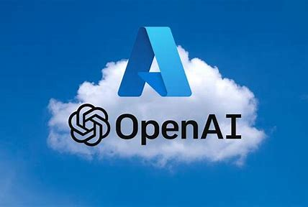


Tools Used For Development
Streamlit
Python
Azure | OpenAI
12

Slide 13



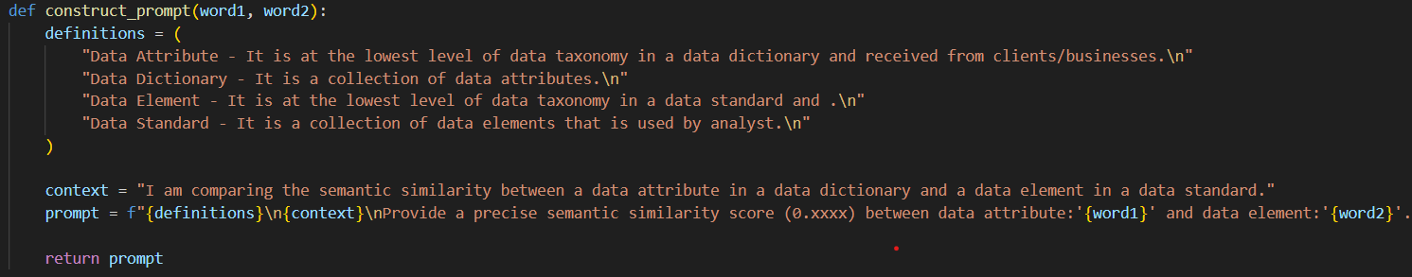
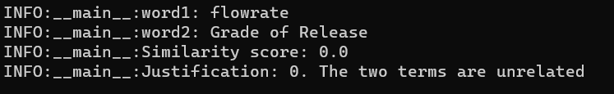
Mechanism (How it works)
Prompt to model
Model send request to OpenAI server
Model provide response
User
Model
Server
13

Slide 14

Optimization 1 - Added Justification
Increases semantic similarity score
This is due to the increased capability of AI in generating reasoning to back-up the answers provided.

Slide 15
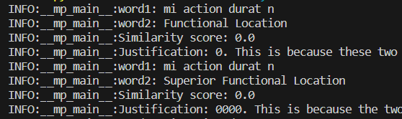
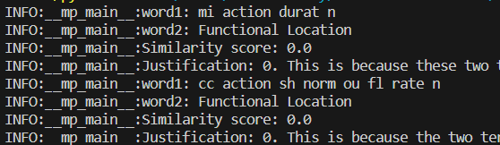
Optimization 2 – Batch processing (parallel processing)
1
1
2
2
Sequential processing
Parallel processing
1 string matching running at a time
2 string matching of difference attribute run at the same time.
Est. time (2 attributes): 12 mins
Est. time (2 attributes):
6 mins

Slide 16

Optimization 3 – Provide Definitions & Context
Definitions and context are provided within prompt.
Will allow AI to understand more on context and provide a better response.

Slide 17
Conclusion
17

Slide 18

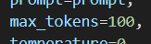
Challenge 1 – Token Limit
Increase in number of tokens produced over time
Reached max limit of tokens generated in a response easier

Slide 19
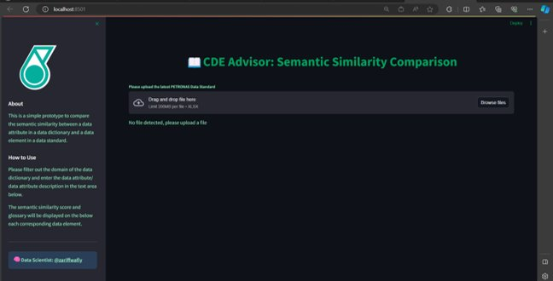
Challenge 2 – local Program
The webapplication is usable as a regular local python program.
Causes inconvenience to users to run the program.

